Slide 1
Building a Culture of Open Science in the Education Community: Data on Adoption and a Platform for Change

Slide 2
Open Science in the Education Community
Bryan G. Cook
University of Virginia

Slide 3
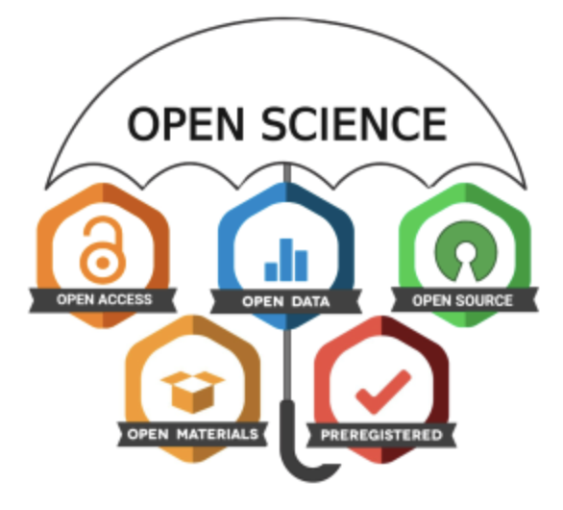
Open Science is an Umbrella Phrase

Slide 4
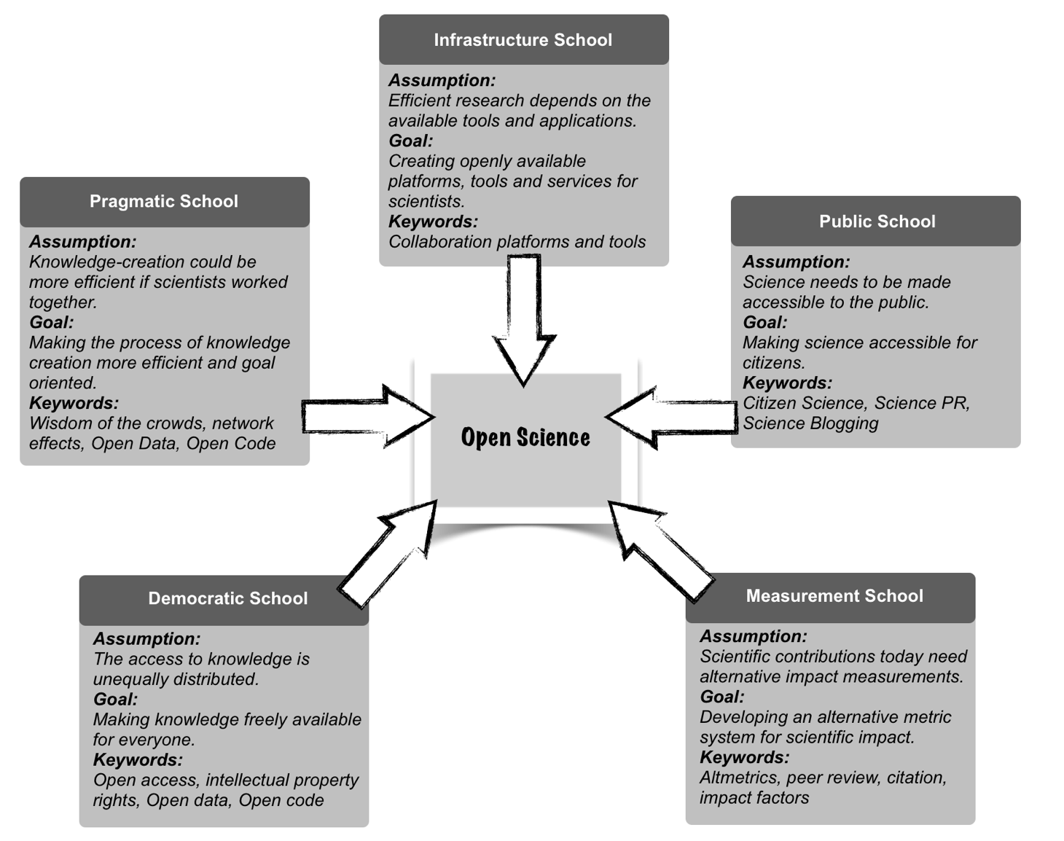
Five Schools of Open Science Thought
Flecher & Friesike, 2014

Slide 5
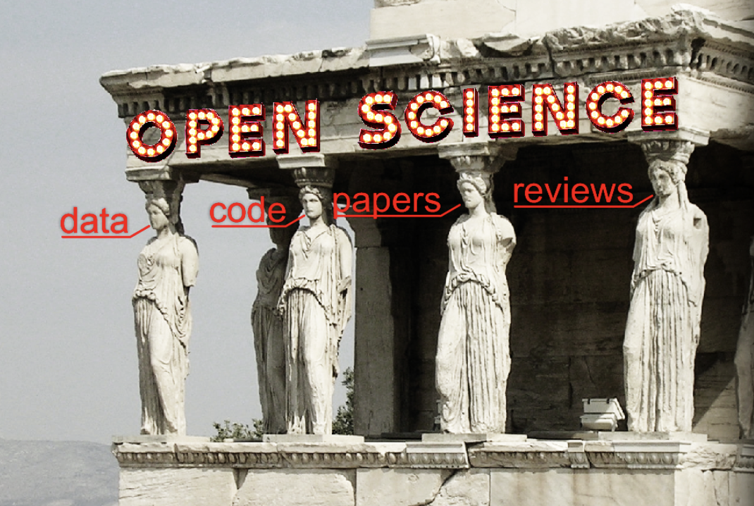
Four Pillars of Open Science

Slide 6
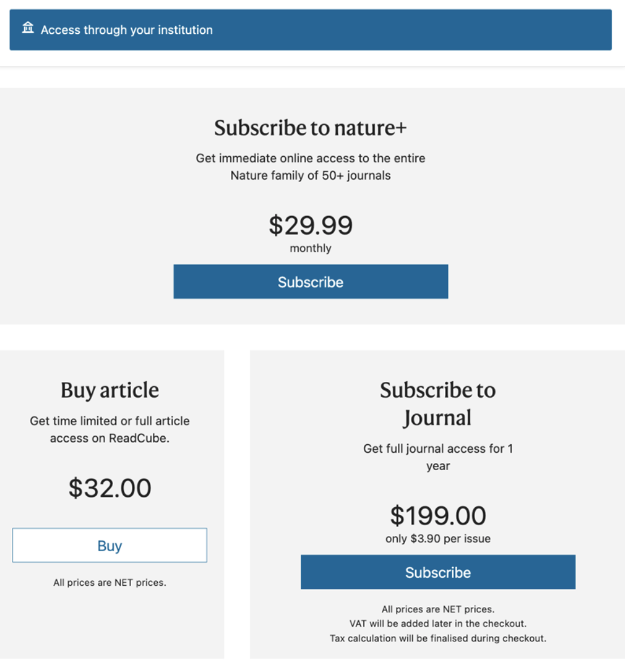
Why?

Slide 7
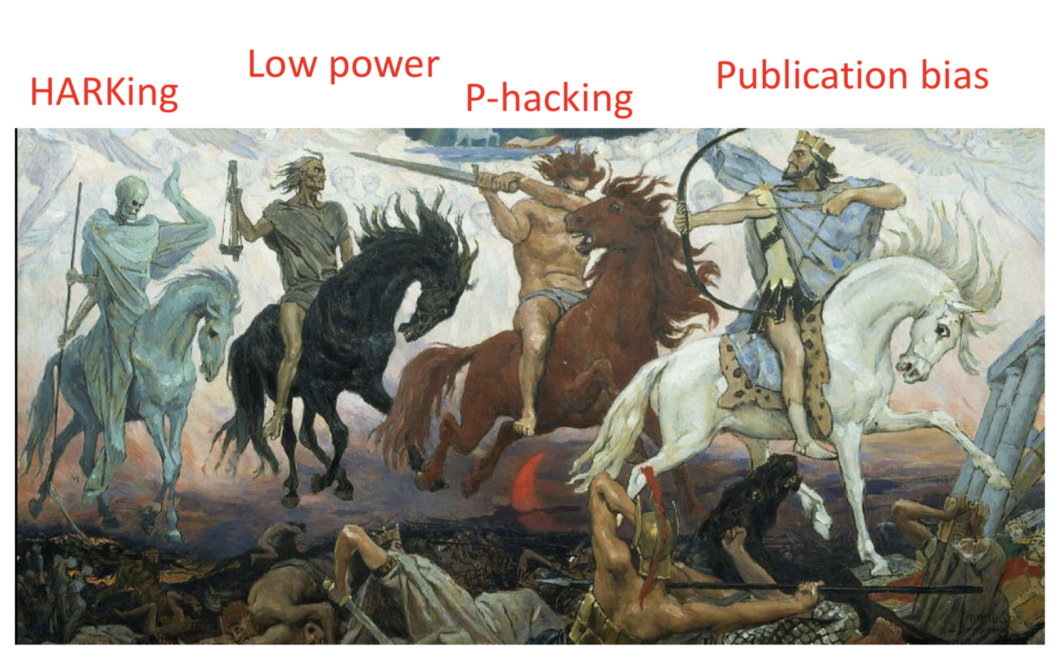
Why?
Bishop, 2019

Slide 8
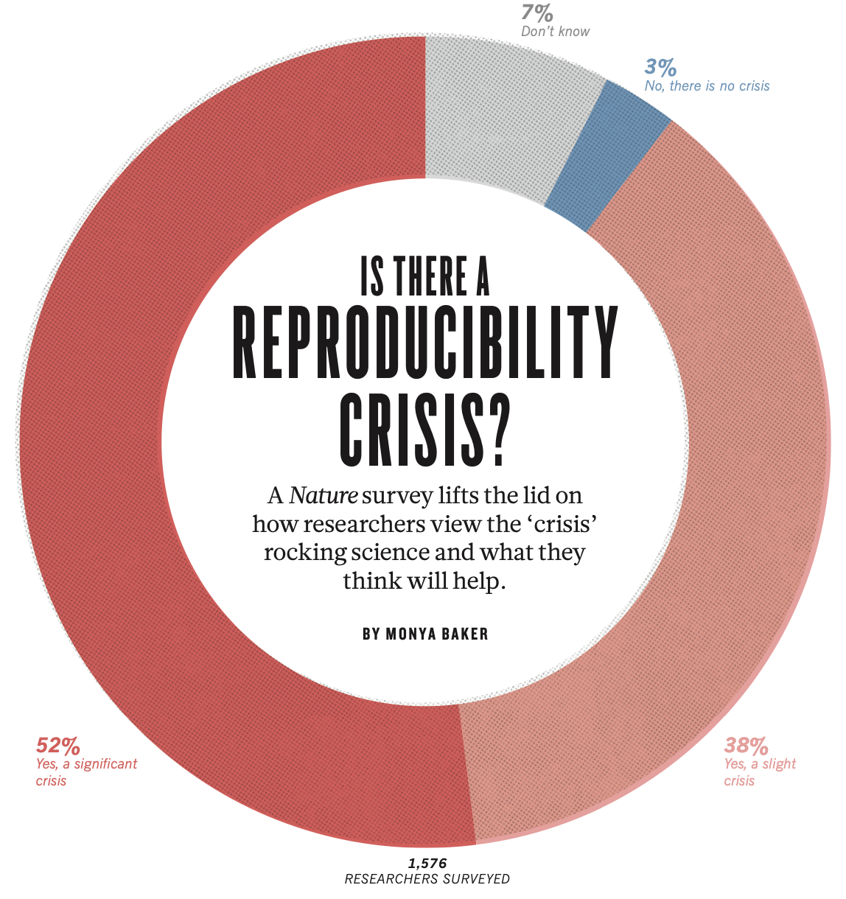
Why?
Baker, 2016

Slide 9
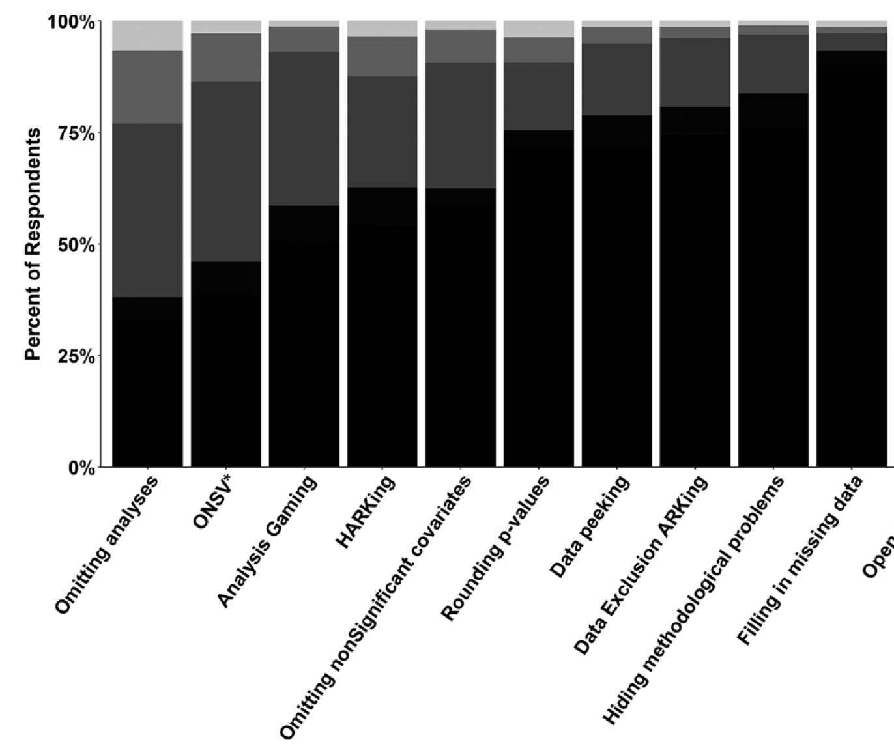
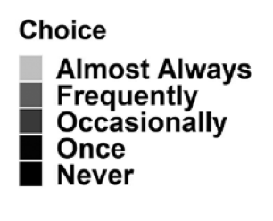
Do QRPs Occur in Education Research?

Slide 10
Some open-science practices that may help to address these issues:

Slide 11
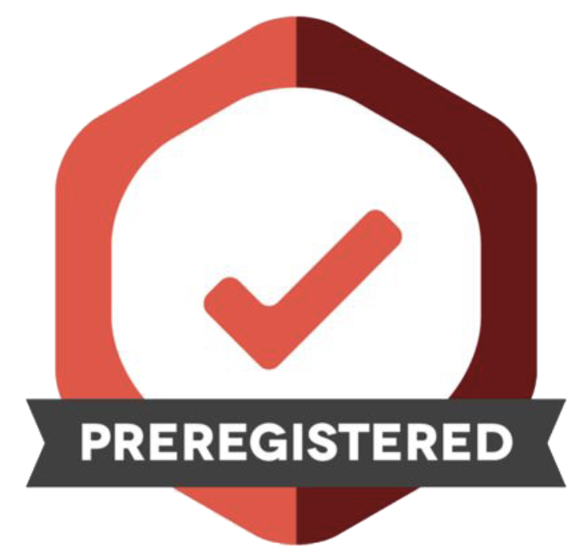
Pre-Registration

Slide 12
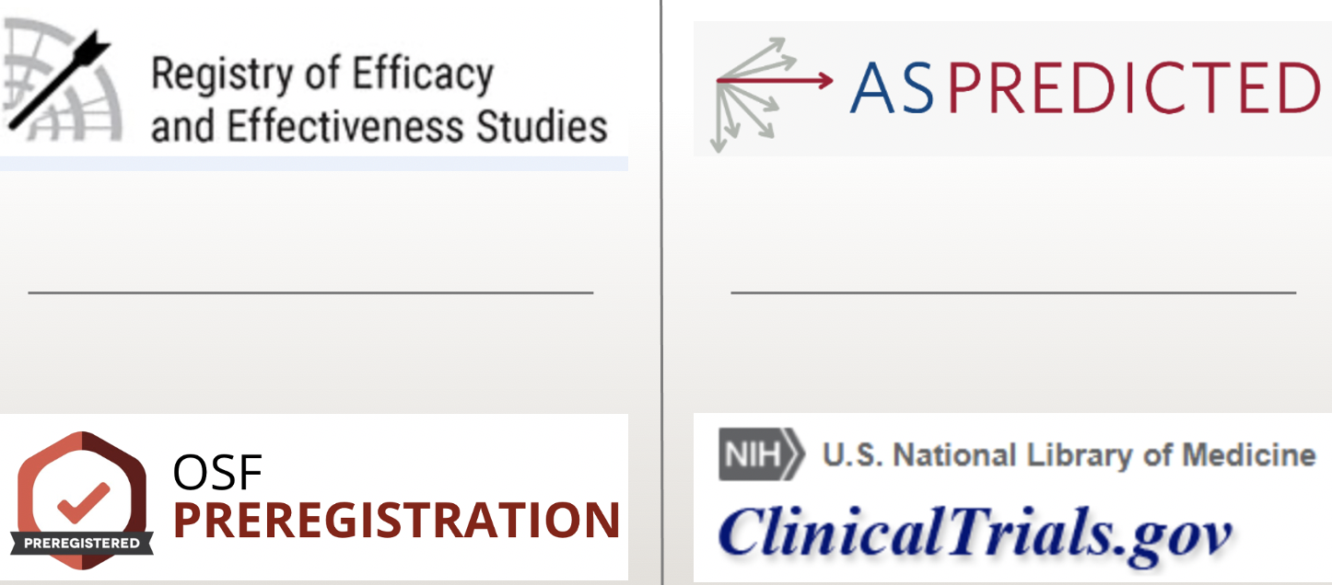

Slide 13
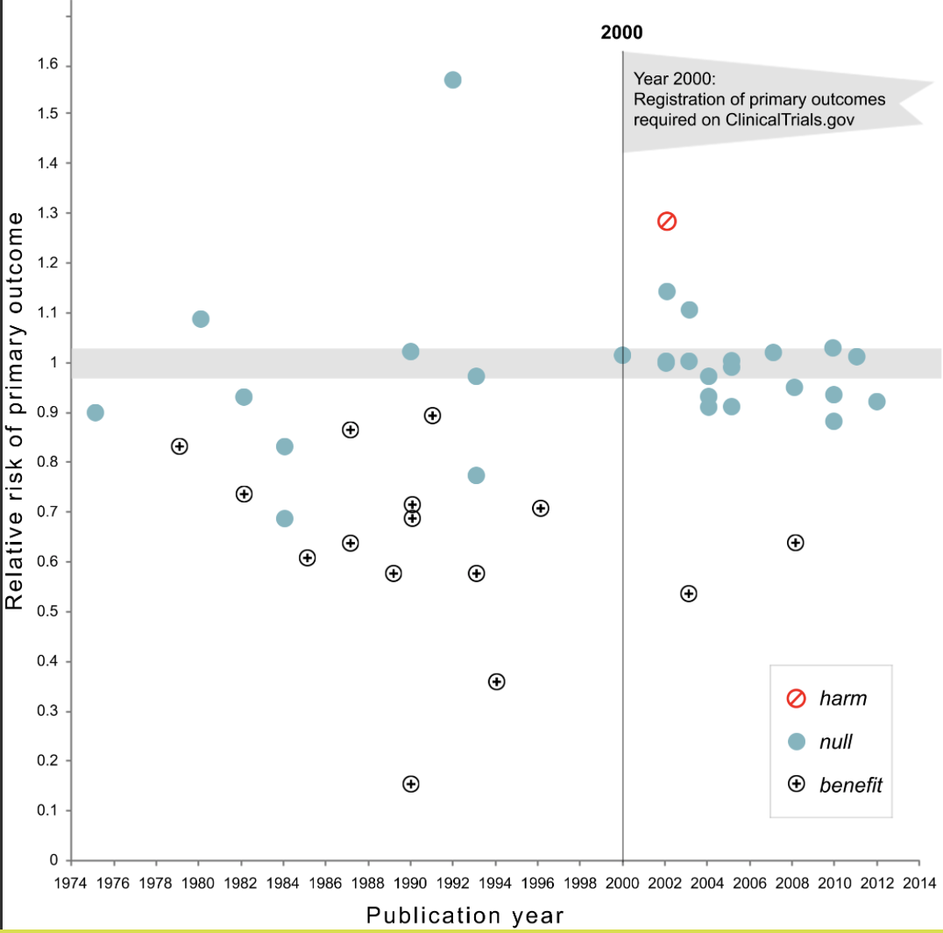
Kaplan & Irvin, 2015

Slide 14
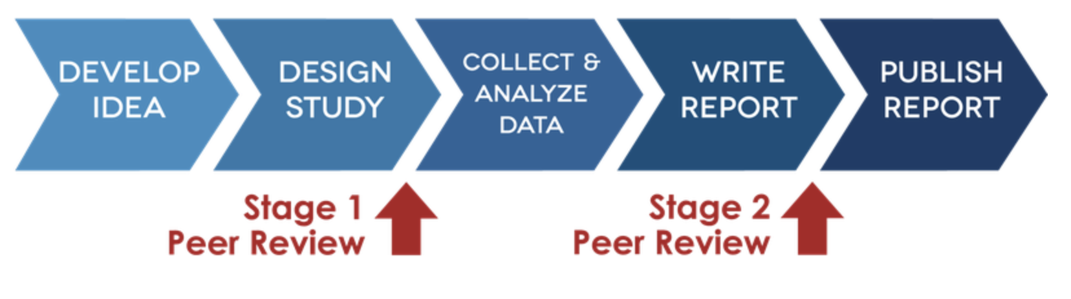
Registered Reports

Slide 15
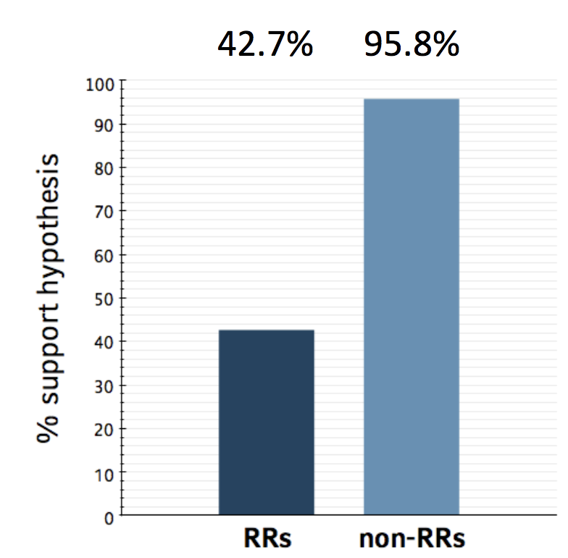
Schijen et al., 2019

Slide 16

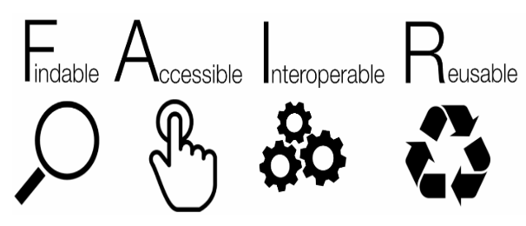
Open Data

Slide 17





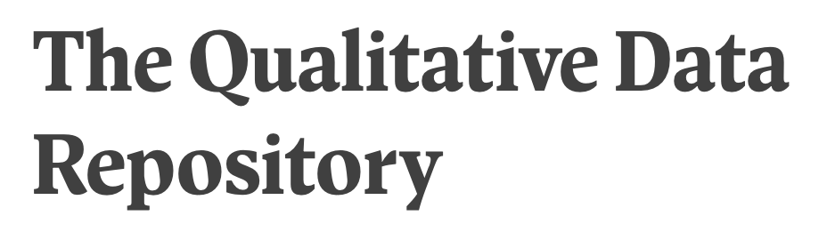



Slide 18

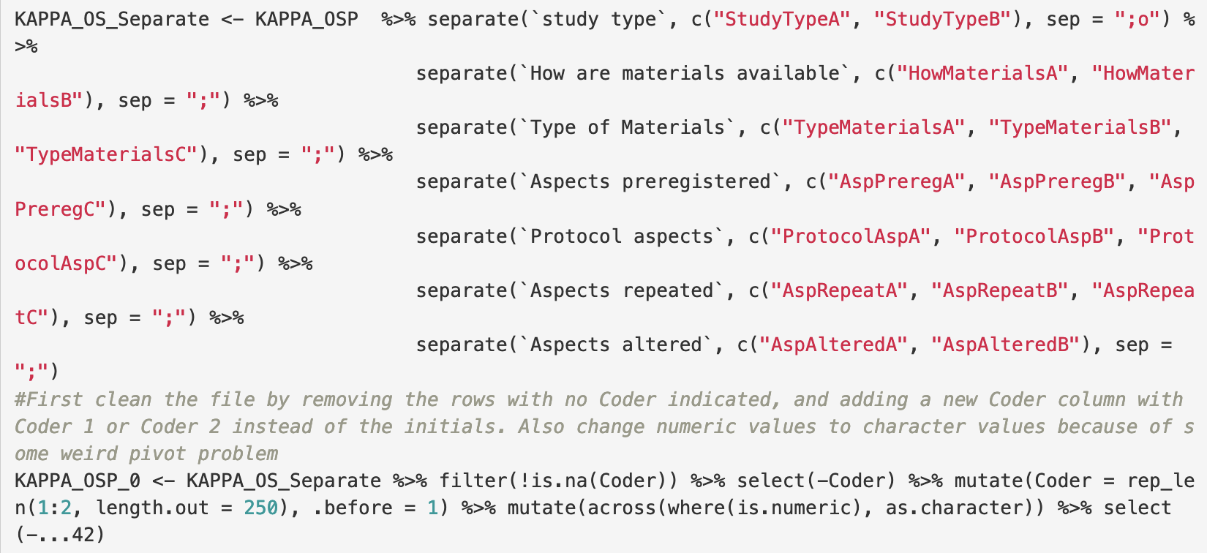
Open Code

Slide 19
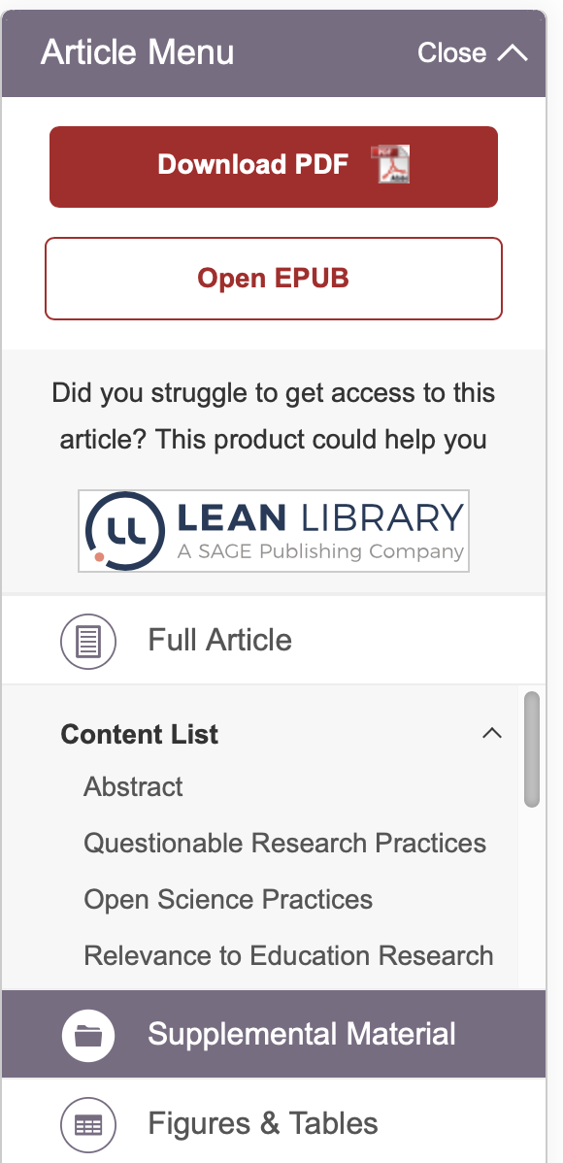
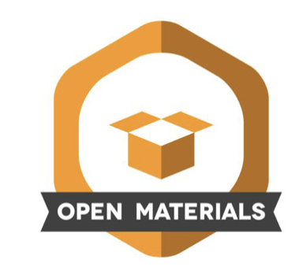

Open Materials

Slide 20
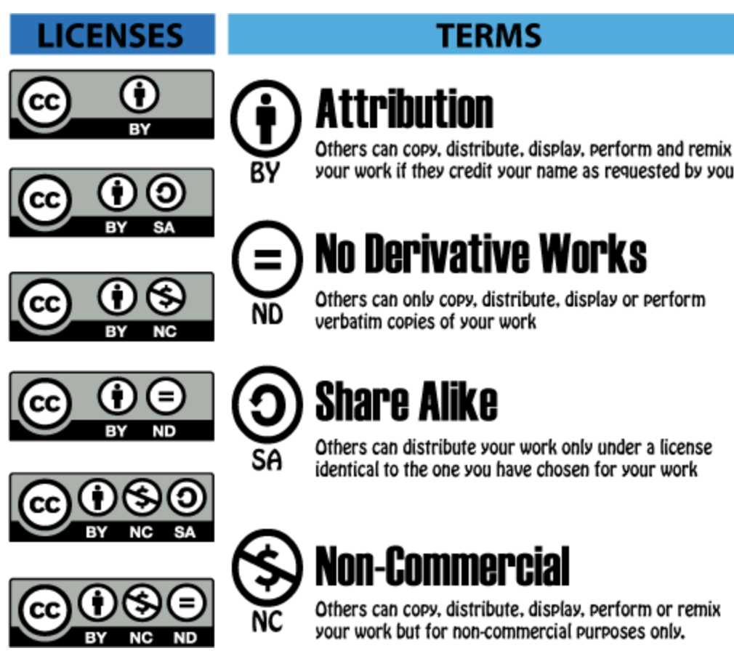

Slide 21
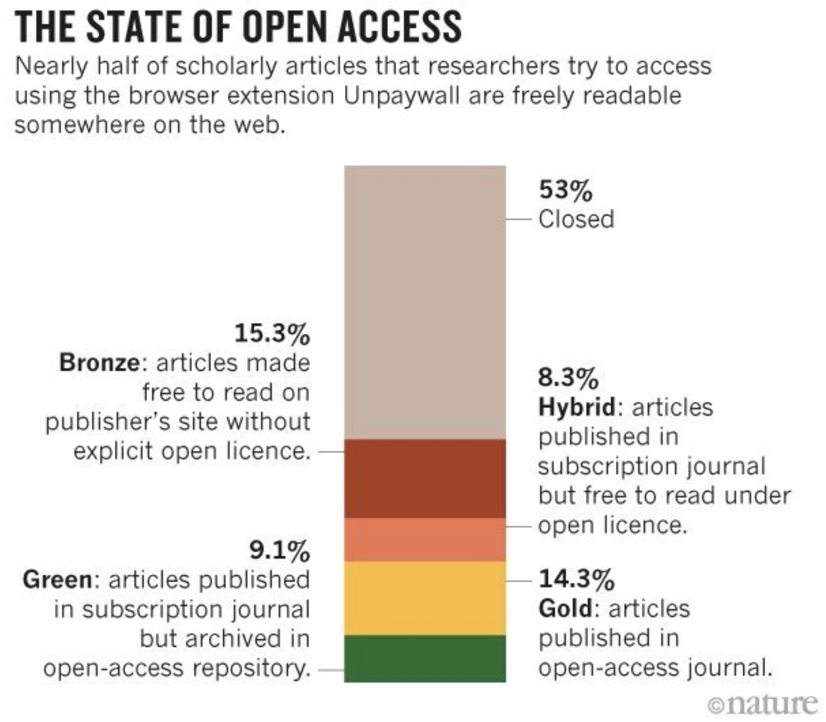

Open Access

Slide 22



Slide 23

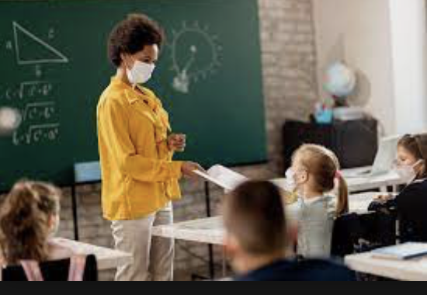

Slide 24

Open Scholarship Survey
Data on Education Researchers' Open Science Attitudes and Behaviors

Slide 25
About the OSS
Standardized, modular survey to assess:
Personal attitudes
Past behaviors
Perceptions of norms within one’s community
Standard items facilitate aggregate and comparative analyses
Multiple waves of survey administration → change over time
Among different research communities → across communities

Slide 26
Open Scholarship Survey (OSS) Modules
Sharing data
Sharing materials
Preregistering studies
Conducting replications
Sharing preprints
Reporting null results as the main result
Perceptions of replication, robustness, and reproduction studies

Slide 27
OSS Activities to Date
Wave 1 administered to 12 communities in 2020-2021
Education: Invited 9,200 researchers for 1,044 responses
Across communities: Invited ~55,000 for ~3,600 responses
Education (n = 1044)
Psychology (n = 407)
Oncology (n = 128)
Criminology (n = 295)
Neurofibromatosis (n = 162)
Pediatric oncology (n = 221)
Research evidence (n = 292)
Parkinson’s (n = 106)
Focused ultrasound (n = 304)
Cardio/Cerebrovascular (n = 174)
Influenza (n = 228)
Consciousness (n = 301)
Notes:
Education as part of STEM Hub NSF grant; others as part of RTI NSF grant

Slide 28
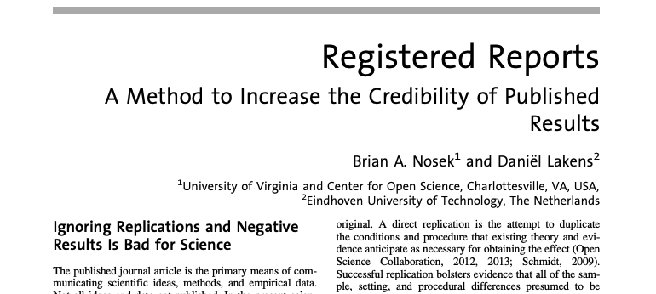
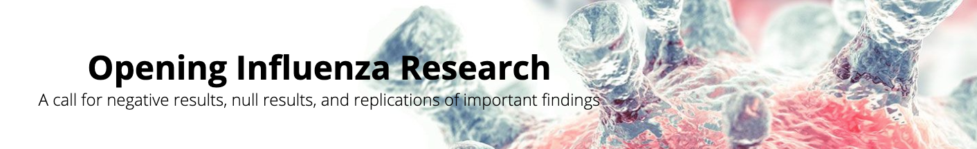
What can the OSS be used for?
Data can be used to inform policy-making efforts by journals, funders, and institutions for promoting open scholarship
(i.e., “Rigor and Transparency Initiatives”)
Laura and John Arnold Foundation and Social Psychology
Flu Lab and PLoS

Slide 29
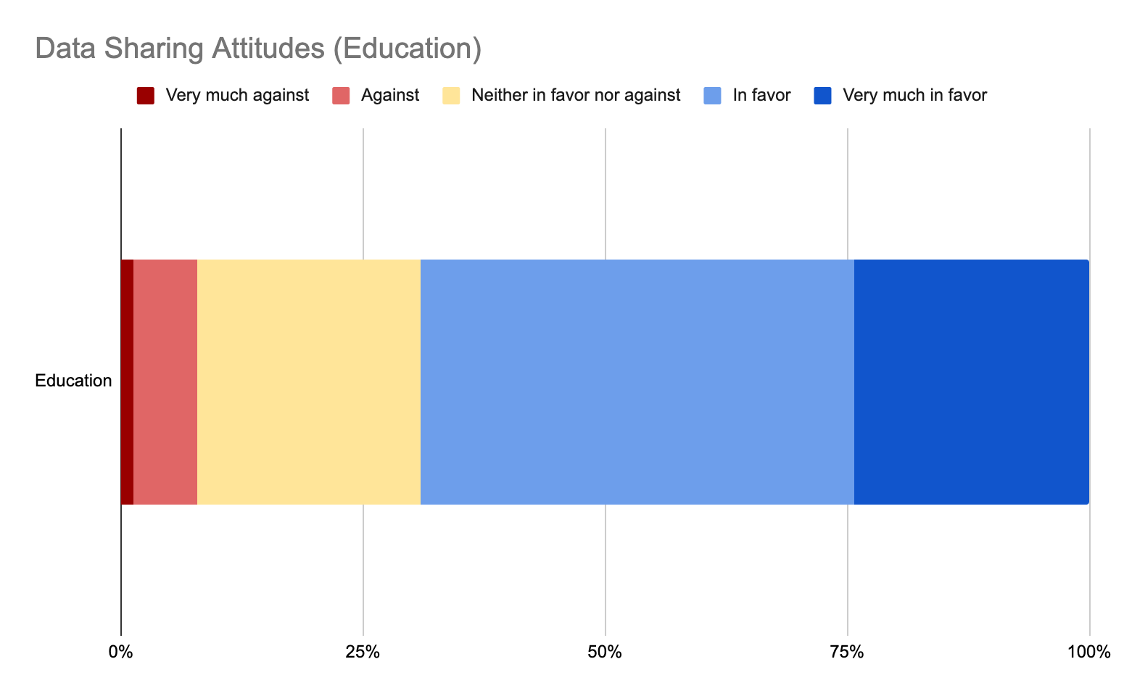
Notes:
(data_attitude) What is your opinion of sharing data in an independent repository?
Reality: 69% favor, 8% against

Slide 30
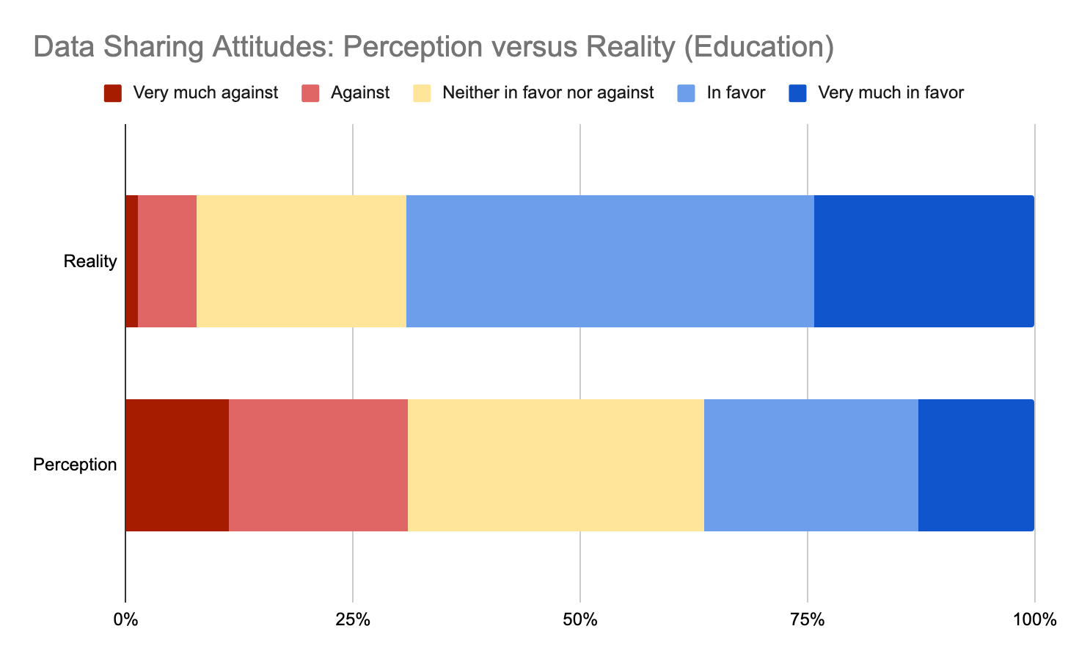
8%
69%
31%
36%
Notes:
(data_attitude; Reality) What is your opinion of sharing data in an independent repository?
69% favor, 8% against
Versus
(data_attitude_norm_1; Perception) In your estimation, what is the distribution of opinion across your discipline about sharing data in an independent repository? In other words, what percentage of researchers fall into each opinion category? (Total must sum to 100.)
36% favor, 31% against

Slide 31
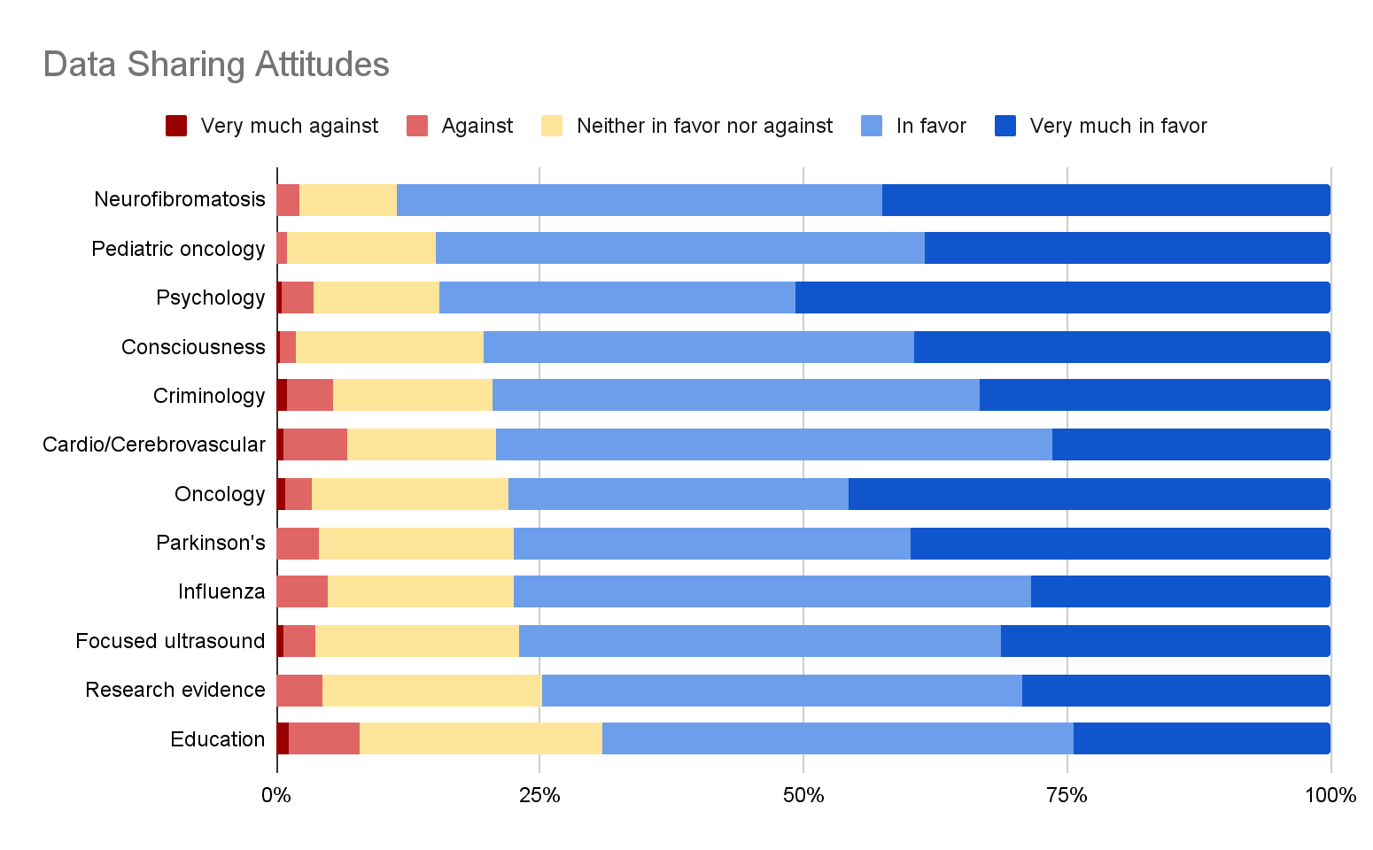
Notes:
(data_attitude) What is your opinion of sharing data in an independent repository?
Reality
% Favoring % Against
88% 2%
85% 1%
85% 4%
80% 2%
79% 5%
79% 7%
78% 3%
78% 4%
77% 5%
77% 4%
75% 4%
69% 8%

Slide 32
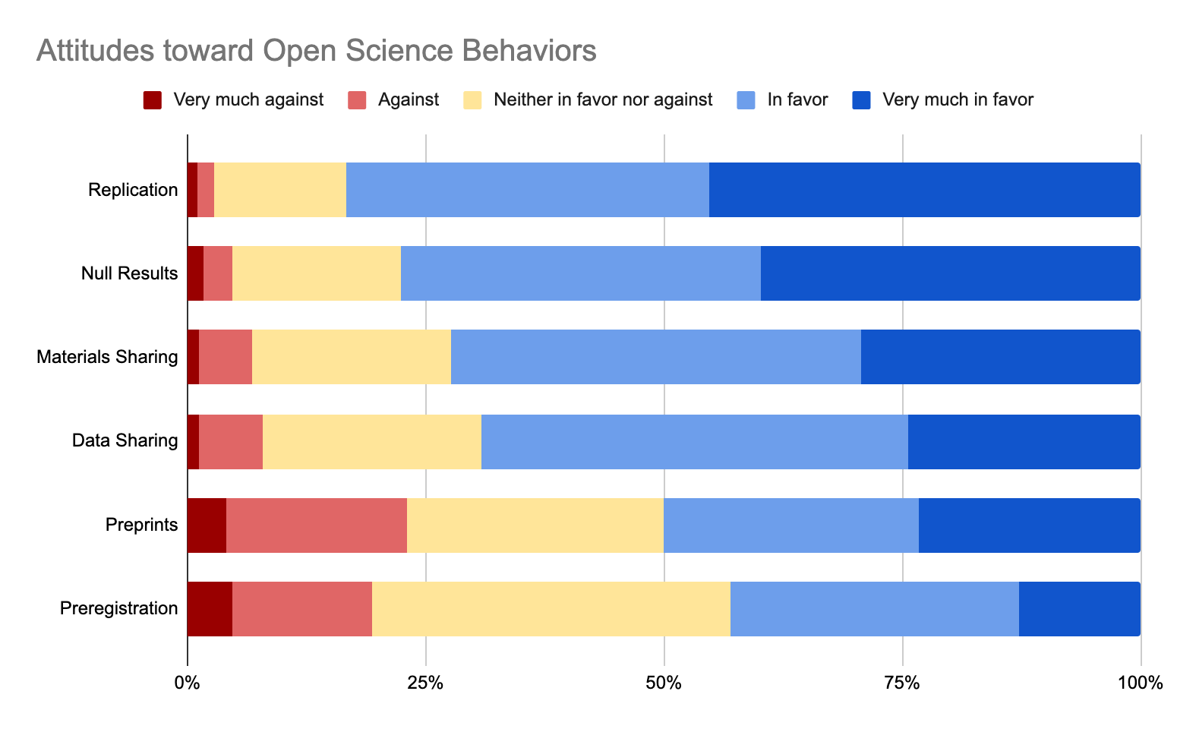
83%
78%
72%
69%
50%
43%

Slide 33
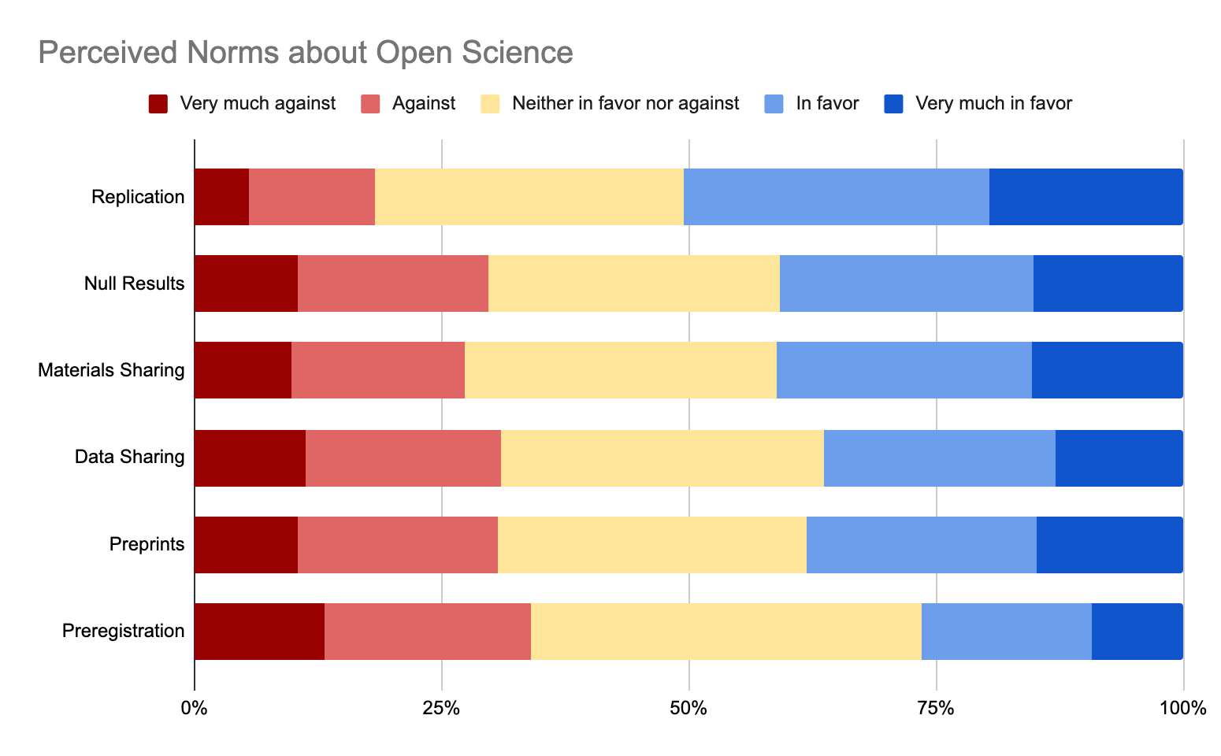
51%
41%
41%
36%
38%
26%

Slide 34
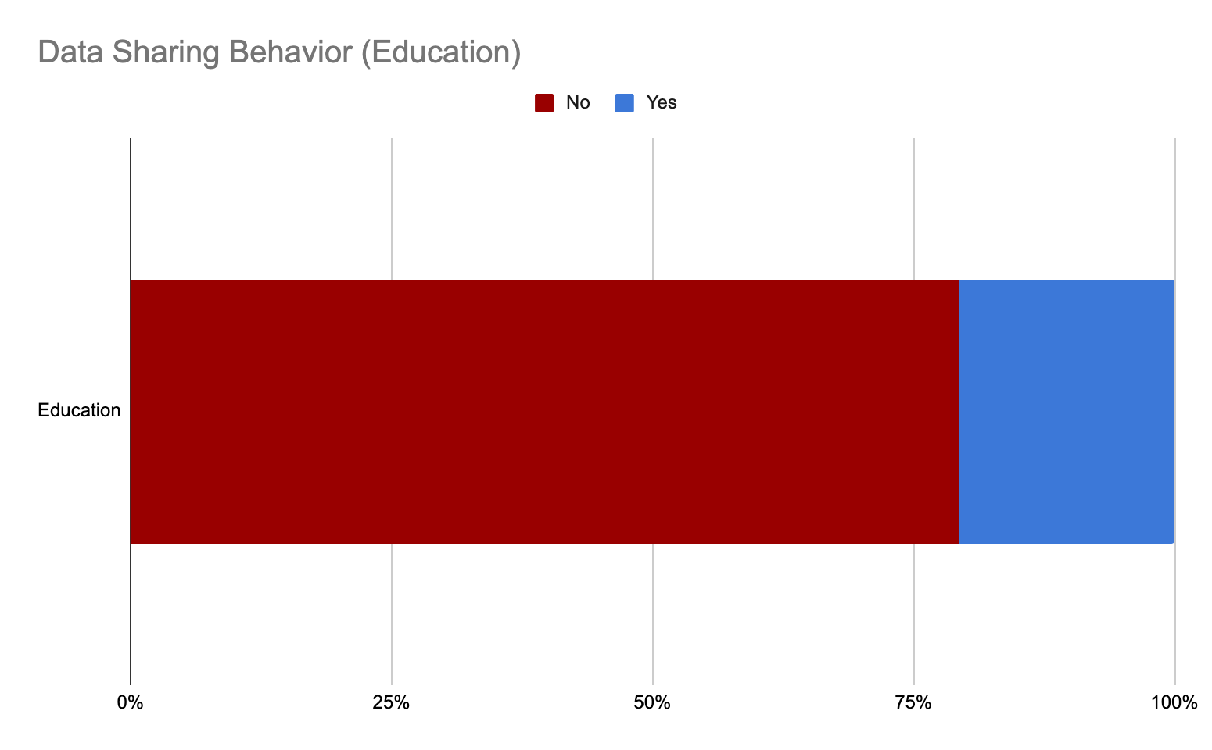
Notes:
(data_recent) Think about your most recent scholarly work that used data. Are data for that scholarly work shared in an independent repository?

Slide 35
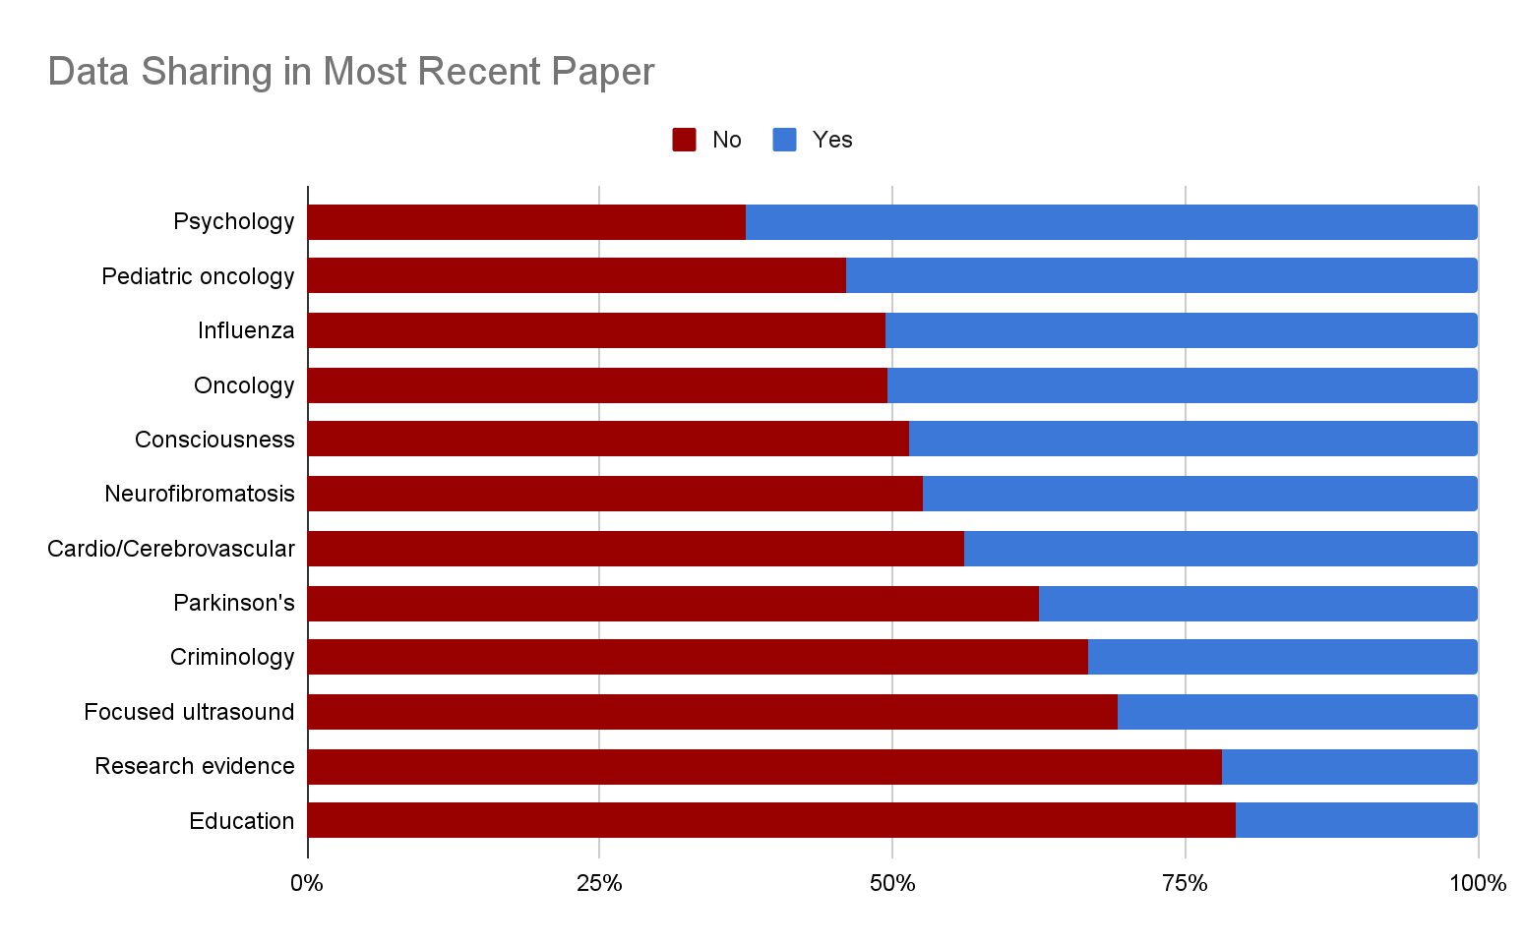
Notes:
(data_recent) Think about your most recent scholarly work that used data. Are data for that scholarly work shared in an independent repository?
% Yes
63%
54%
51%
50%
49%
47%
44%
38%
33%
31%
22%
21%

Slide 36
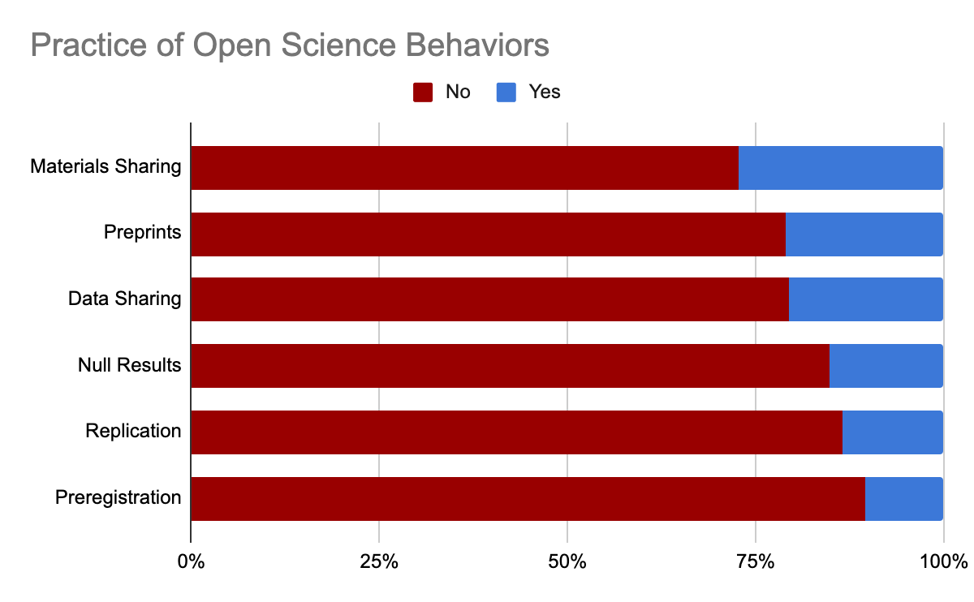
27%
21%
21%
15%
13%
11%

Slide 37
Overview
Attitudes toward open scholarship are very favorable.
Perceptions underestimate community positivity toward open scholarship.
There is some variation across disciplines and topics.
There is some behavior on all open scholarship topics in all disciplines.
Behavior is lagging attitudes.

Slide 38
What’s next for the OSS?
Wave 2 of OSS administration coming up soon!
Prioritizing follow-up with participants from Wave 1 (~1k)
Launching to up to ~31k new participants, corresponding authors of education research publications published within the last two years
Continued work with funders to organize potential initiatives to encourage open science practices
Shared data from Wave 1 (osf.io/nsbr3)
Exploration of potential applications of the OSS
OSF users
OSF institutions

Slide 39
Thanks for listening!
Please send any questions to krystal@cos.io
To check out the data, visit our OSF page at osf.io/nsbr3
And visit cos.io/initiatives/open-scholarship-survey for more!

Slide 40
The OSKB Erin M. Buchanan, Ph.D. Harrisburg University @aggieerin

Slide 41
What is the Open Scholarship Knowledge Base?
We are a community of advocates working with researchers, educators, and anyone interested in open scholarship to build a knowledge base so that researchers and users can learn and apply open practices.
Notes:
Our aim
Build a knowledge base platform and a community of contributors to organize information on the what, why, and how of open scholarship so it is easy to find and apply. Contributors keep the information up-to-date and curate modules for self-learning or teaching.

Slide 42
What is the Open Scholarship Knowledge Base?
Community
Diverse individuals and groups aligned by a shared goal to make learning and applying open research practices easier.
Project
To curate and share knowledge about the what, why, and how of open scholarship.
Platform
Building, curating, and maintaining a community-led hub of modular educational resources.
Notes:
April
Community:
Spearheaded by volunteers at a Society for the Improvement of Psychological Science meeting
Community of diverse individuals aligned by a shared goal to make learning and applying open research practices easier
Built by and for the community it aims to serve.
Researchers, teachers, funders, librarians, and anyone wanting to open scholarship are welcome to edit, curate, and contribute to this community resource.
In the spirit of openness, we welcome a diversity of ideas, tools, and methods. Anyone looking to adopt and spread open scholarship is invited to join us.
Project including reviewing, consolidating, organizing, and improving the discoverability of content to support the education and application of open practices for all aspects of the research lifecycle.
Platform will be a hub, designed by and for the community, where educational resources are built, curated, and maintained. We have with us Megan Simmons from the OER Commons who will talk a bit about what an OER Commons OSKB Hub will be able to do.

Slide 43
Why did we build the OSKB?
Knowledge gaps
Barriers to adoption
Discoverability of resources
Notes:
Felix
Some preliminary notes on what I’d try to say here:
There are many excellent resources out there already (as April probably noted on the previous slide), many of them well-known to folks who follow the literature or Open Science twitter
Many of these are not as well known as they deserve to be -> knowledge gaps around Open Science best practices
Lack of knowledge creates uncertainty -> barrier to doing Open Science
Our goal: Bring together fellow scientists with common questions around open science and the resources that can help answer those questions.

Slide 44
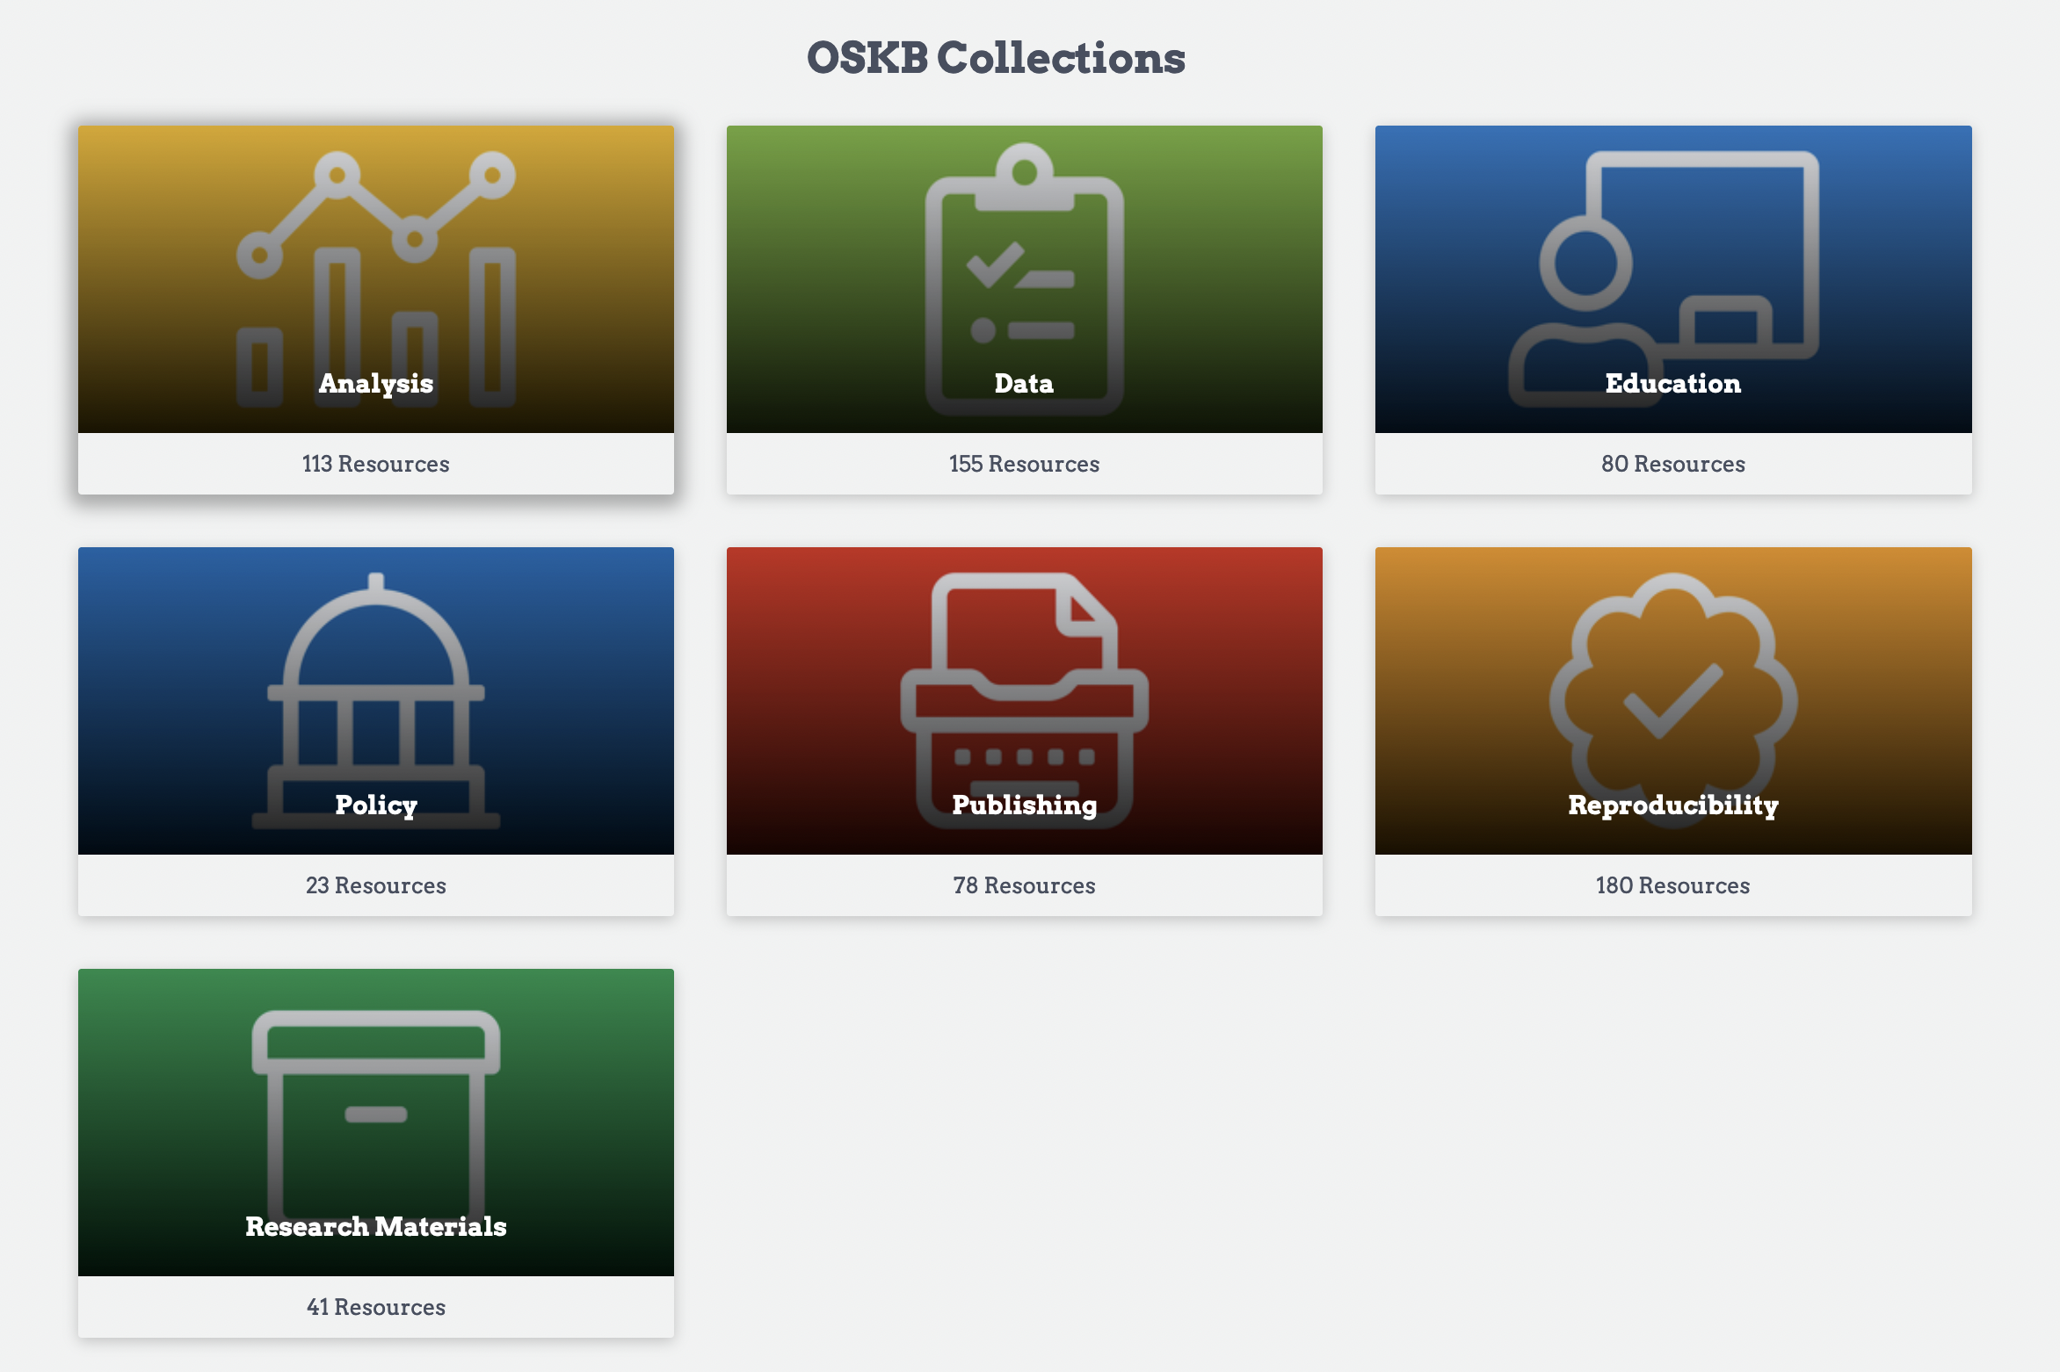

Slide 45
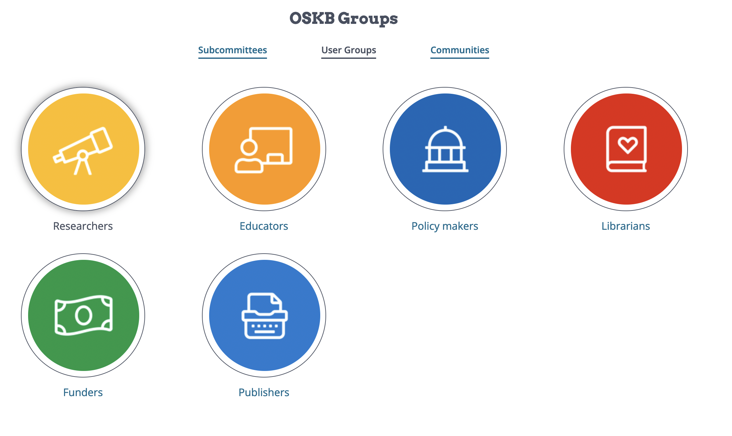

Slide 46
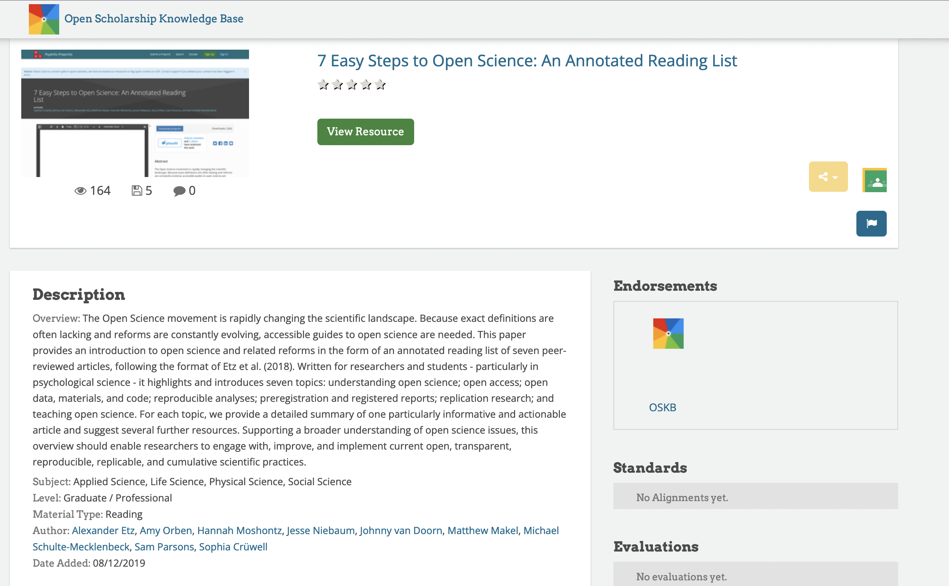

Slide 47
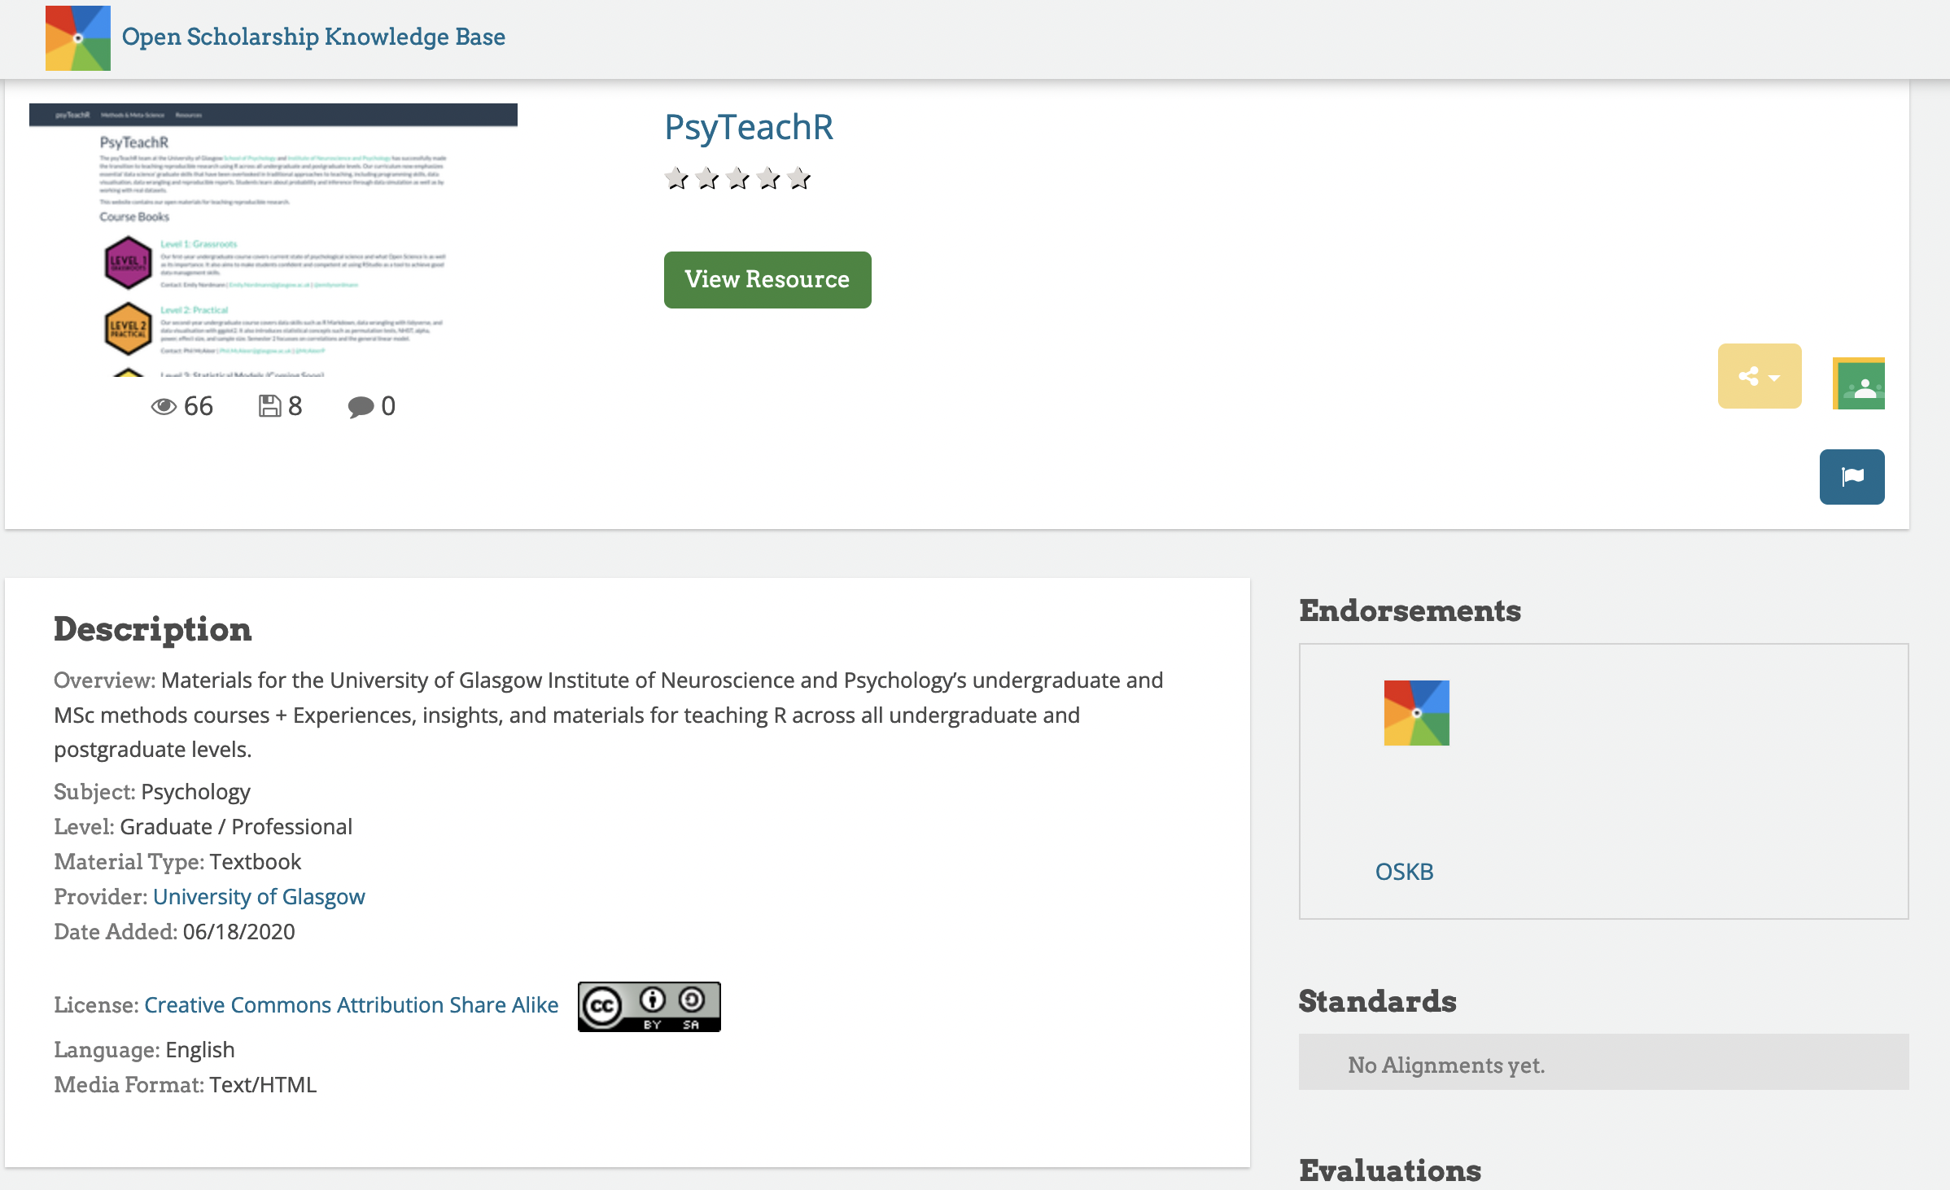

Slide 48
Diversity and Inclusion in the OSKB
Resources primarily from WEIRD communities
Resources are in English
Resources are generally psychology-focused
Diversify users to help diversify materials

Slide 49
Contribute to and improve the OSKB
Add a resource
Review and improve a resource
Test and improve our prototype
Fill a knowledge gap by authoring a resource
Join the community:
Sign up and come to our community call!
Monthly meetings to improve and expand the OSKB
No experience necessary!
Notes:
April

Slide 50
Keeping Inclusion, Diversity, Equity, and Access in the Forefront of the Open Science/Scholarship Movement
Crystal N. Steltenpohl
Dartmouth Center for Program Design and Evaluation
@CrystalNSYoung

Slide 51

Current Focal Points of Open Science Movement
Collaboration, particularly through technology
Sharing materials, data, and code
Making the research process and products more findable
Changing incentive structures
Reaching non-academic audiences
Replication
Reproducibility

Slide 52

“What I learned from my experience and observations, and from reading, was that leaders rarely seriously and systematically list and think through the predictable problems. Enamored as they are with visions of what the setting should and will be, and secure in the feeling (it is usually no more than that) that they will surmount whatever problems will arise, they hardly pay attention to the predictable problems.
For them, the creation of the setting is not a very complicated cognitive planning-'what if' process, but rather a personal-motivational one in which clarity of and adherence to ends are far more salient than means.”
Seymour Sarason

Slide 53

Open to whom?
What fields are we paying the most attention to?
Whose work are we prioritizing?
What methods/epistemologies do we value?
Do the suggested reforms work for researchers in different countries?
What risks or barriers are there for those who are earlier in their careers?
What resources are unavailable for educators and researchers not at R1 institutions?

Slide 54
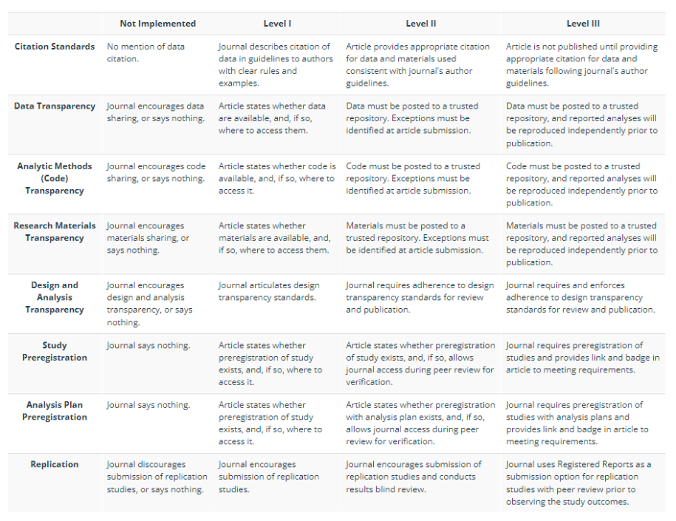
TOP Guidelines
What research paradigms are we leaving out when “higher ranked” journals require preregistrations?

Slide 55
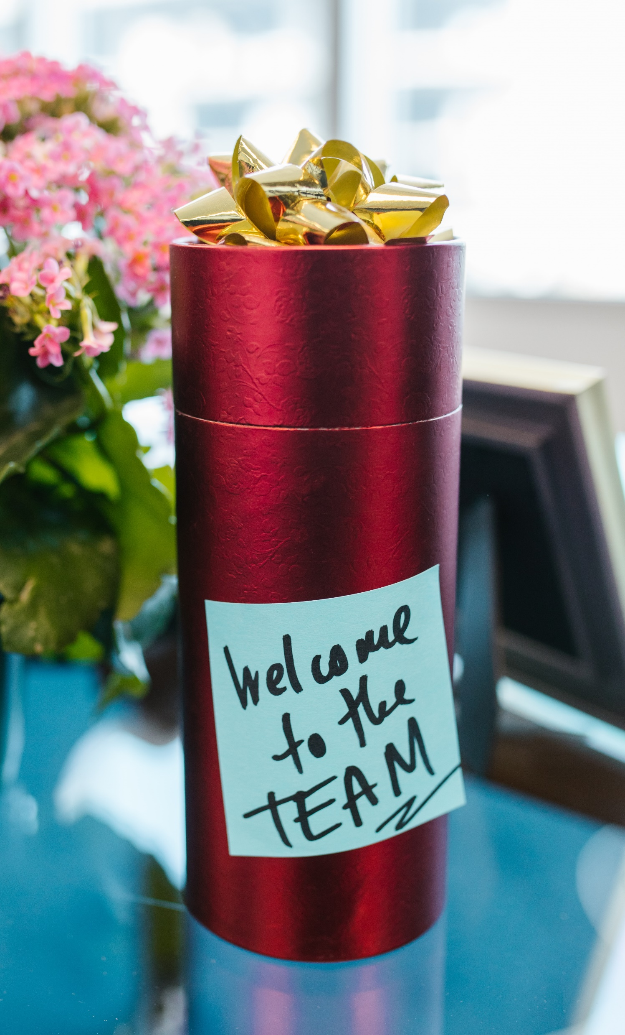
Opening Up Open Science
Build partnerships with regional and field-specific organizations with similar goals/values
Support initiatives to expand open access
Hold and attend conferences in geographically diverse locations
Ensure remote events are accessible in terms of cost, technology requirements, and disability accommodations
Listen to researchers from a variety of backgrounds
Be careful about generalizing
Include diverse voices when teaching about open science
Steltenpohl, C. N., Montilla Doble, L. J., Basnight-Brown, D., Dutra, N. B., Belaus, A., Kung, C., Onie, S., Seernani, D. P., Chen, S., Burin, D. I., & Darda, K. M. (2021). Society for the Improvement of Psychological Science Global Engagement Task Force Report. Collabra: Psychology, 7(1), 1-22.

Slide 56


Where to start?
oercommons.org/hubs/OSKB
Bulhan, H. A. (2015). Stages of colonialism in Africa: From occupation of land to occupation of being. Journal of Social and Political Psychology, 3(1), 239-256.
Devezer, B., Nardin, L. G., Baumgaertner, B., & Buzbas, E. O. (2019). Scientific discovery in a model-centric frame-work: Reproducibility, innovation, and epistemic diversity. PloS One, 14(5), e0216125.
Downes, S. (2007). Models for sustainable open educational resources. Interdisciplinary Journal of E-Learning and Learning Objects, 3(1), 29-44.
Mishra, S. (2017). Open educational resources: Removing barriers from within. Distance Education, 38(3), 369-380.
Steltenpohl, C. N., Montilla Doble, L. J., Basnight-Brown, D. M., Dutra, N. B., Belaus, A., Kung, C. C., ... & Darda, K. (2021). Society for the Improvement of Psychological Science Global Engagement Task Force Report. Collabra: Psychology, 7(1), 22968.
Syed, M., & Kathawalla, U. K. (2020). Cultural psychology, diversity, and representation in open science. In K. C. McLean (Ed.), Cultural methodologies in psychology: Capturing and transforming cultures. New York: Oxford University Press.
Wagge, J. R., Brandt, M. J., Lazarevic, L. B., Legate, N., Christopherson, C., Wiggins, B., & Grahe, J. E. (2019). Publishing research with undergraduate students via replication work: The collaborative replications and education project. Frontiers in Psychology, 10, 247.

